Slide 1
Animal Biotechnology Lecture 1 Biotechnology and transgenic animals

Slide 2
What is Biotechnology?
Biotechnology (sometimes shortened to "biotech") is the use of living systems and organisms to develop or make useful products or process for a variety of applications. Biotechnology is defined as the application of scientific and engineering principals to the processing of material by biological agents to provide goods and services. Biotechnology comprises a number of technologies based upon increasing understanding of biology at the cellular and molecular level. Thus biotechnology is important because it may provide solutions to many major global issues, including world hunger and pollution. It also provides exciting advances in the medical field, from improving vaccine production to tissue engineering from bio materials

Slide 3
What is Biotechnology?
Biotechnology existed long before there was a special word for it. Many of the principles and some of the techniques involved in biotechnology are ancient. For example, fermentation, in which microbes are used, has been practiced for thousands of years to produce beer, wine, cheese, bread, and yogurt.
Traditional animal and plant breeding techniques are also a form of pre-industrial biotechnology.
What is new about biotechnology today is that researchers can take a single gene from a plant or animal cell and insert it into another plant or animal cell of a different species (this is called transgenic technology).
Modern biotechnology also includes altering the genes within an organism to control the production of a particular protein. Changing genes in this way can go far beyond the changes that occur naturally during evolution, or the artificial, but slower, changes brought about by traditional selective breeding.
Modern biotechnology is distinguished from traditional biotechnology in that:
1. faster
2. More precise and produces predictable results

Slide 4
What is a transgenic organism
Gorden and Ruddle in 1981 coined the term “transgenic” to explain an animal in which an exogenous gene was introduced into its genome.
In the late 1980s, the term transgenic was extended to gene-targeting experimentation and the production of chimeric or “knockout” mice in which a gene (or genes) has been selectively removed from the host genome.
A transgenic animal: one having any specific, targeted genetic modification.
There are a number of methodologies which can be utilized for the production of transgenic animals will be discussed later.

Slide 5
Methodologies that can be used for the production of transgenic animals
1. DNA microinjection.
2. DNA transfer by retroviruses.
3. Injection of embryonic stem (ES) cells and/or embryonic germ (EG) cells, previously exposed to foreign DNA, into the cavity of blastocysts.
4. Microinjection of genes into pronuclei of fertilized ova.
5. Sperm-mediated exogenous DNA transfer during in vitro fertilization.
6. Liposome-mediated DNA transfer into cells and embryos.
7. Electroporation of DNA into sperm, ova or embryos.
8. Biolistics (gene gun technology).
9. Nuclear transfer (NT) with somatic cells.

Slide 6
Reasons for producing transgenic animals
1. Gain new knowledge.
2. Decipher the genetic code.
3. Study the genetic control of physiological systems.
4. Build genetic disease models.
5. Improve animal production traits.
6. Produce new animal products.

Slide 7
Animal Biotechnology & Transgenic Animals
Since the early 1980s, several transgenic organisms have been produced such as: fruit flies, fish, sea urchins, frogs, laboratory mice and farm animals, such as cows, pigs, and sheep.
The ability to manipulate the genome of the whole animal and the production of transgenic animals has influenced the science dramatically in the last 15 years.
The procedure for introducing exogenous donor DNA into a recipient cell is called Transfection.
Chromosomes are taken up inefficiently so that intact chromosomes rarely survived the procedure. Instead the recipient cell usually get a part of the DNA.
What is a transgenic animal? All transgenic animals are altered in a way that is heritable which include:
1. Integration of a fragment of foreign DNA into at least one chromosome
2. Alteration of any gene resulting from introduction of foreign DNA
1. integration of any gene resulting from the introduction of foreign DNA
3. Rearrangement of chromosomes resulting from the introduction of foreign DNA
4. Any introduction of persisted supernumerary genetic entity, for example an entirely artificial chromosome or any extrachromosomal DNA element that is replicated and transmitted to daughter cells.

Slide 8
Now, with the advent of the recombinant DNA, the possibility of introducing a particular segment of DNA become possible. However, still there are always some problems of the stability of the new inserts (transient transfectants).
An exciting development of transfection techniques is the application of DNA technology to introduce genes into animals.

Slide 9
An animal that gains new heritable genetic information from the addition of foreign DNA is described as Transgenic while the introduced DNA is called the transgene.
The transgenes are introduced into the pronuclei of fertilized eggs by injection, and the injected embryos are incubated in vitro or implanted into the uterus of a pseudopregnant female for subsequent development.
What is Pronucleus? For a short time after fertilization, the male pronucleus and female pronucleus exist separately.
Female pronucleus; In the maturing of the ovum preparatory to impregnation, a part of the germinal vesicle becomes converted into a number of small vesicles, which aggregate themselves into a single clear nucleus which travels towards the center of the egg and is called the female pronucleus.

Slide 10
Male pronucleus; In fertilization, the spermatozon which enters the egg soon loses its tail, while the head forms a nucleus, called the male pronucleus, which gradually travels towards the female pronucleus. The male pronucleus in mice is larger than the female’s and can be seen fairly easily under a light microscope.

Slide 11
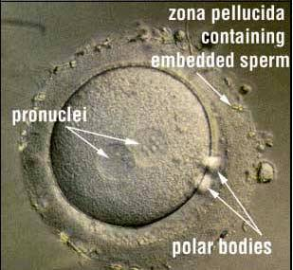

Slide 12
Synopsis of the transgenesis process in mice
Plasmids carrying the gene of interest are injected into the germinal vesicle (nucleus) of the oocyte or into the pronucleus of the fertilized egg.
The egg is implanted into a pseudopregnant mouse
After birth, the recipient mouse can be examined to see whether it has gained the foreign DNA and if so whether it is expressed.
As a result; multiple copies of transgenes are integrated at random locations in the genome of the transgenic individuals.
The transgenes in many transgenic individuals are also transmitted through the germ line All transgenic animals are altered in a way that is heritable which include:
line to subsequent generations.

Slide 13
Note; If the transgenes are linked with functional promoters, expression of transgenes as well as display of change in phenotype is expected in some of the transgenic individuals
Questions to be asked about any transgenic animal are;
how many copies it has of the foreign DNA (varies 1-50)

Slide 14
where these copies are located [usually multiple copies are integrated into a tandem array (arranged adjacent to each other) into a single chromosomal site]
whether they are present in the germ line and inherited in Mendelian manner.
can the gene be expressed independently? i.e does the regulatory elements function independently
are transfected genes expressed with the proper developmental specificity?
A good result if we obtain 15% of the animals to be transgenic.
In the progeny of the infected animal, the expression of the donor gene is extremely variable and that could be dependent on the place of integration of the new DNA.

Slide 15
Transgenesis; Methodology
Transgenic technology has been developed and perfected in the laboratory mouse. Since the early1980’s hundreds of different genes have been introduced into various mouse strains. These studies have contributed to;
understanding of gene regulation
tumor development, example introducing oncogenes and observe the effect

Slide 16
immunological specificity, example producing knockout genes that are responsible for some immunological aspects
molecular genetics of development
other biological interests such as examining the possibility of using transgenic animals in the industrial production of human therapeutic drugs.. etc.

Slide 17
Methods of gene transfer in animals
For transgenesis, DNA can be introduced into mice by one of the following methods;
Retroviral vectors that infects the cells of an early stage embryo prior to implantation into a receptive female.
Physical method such as Microinjection into the enlarged sperm nucleus (the male pronucleus) of a fertilized egg
Introduction of genetically engineered embryonic stem cells into an early stage of developing embryo prior to implantation into a receptive female.
Transfer of diploid somatic nuclei into an enucleated oocyte.(nuclear transfer of somatic cells cloning)

Slide 18
Retroviruses-Mediated Gene Transfer
The retrovirus consists of two copies of a single stranded RNA genome with sequences known as gag, pol, and env, which encode viral structural and catalytic proteins. These are surrounded by a glycoprotein envelope. At the onset of infection, the surface glycoprotein envelope interacts with receptors on the surface of the target cell to gain entry. When inside the cell, the single stranded viral genome is converted into linear double stranded DNA by a virus encoded reverse transcriptase. As the target cell undergoes mitosis, the viral DNA integrates with the target cell DNA—at which point it is known as a provirus. It is this proviral DNA that is manipulated to form retroviral vectors for gene transfer. The provirus then undergoes transcription and translation with the rest of the genome, resulting in the assembly of new viral particles that bud off the surface of the target cell to infect others cells.

Slide 19
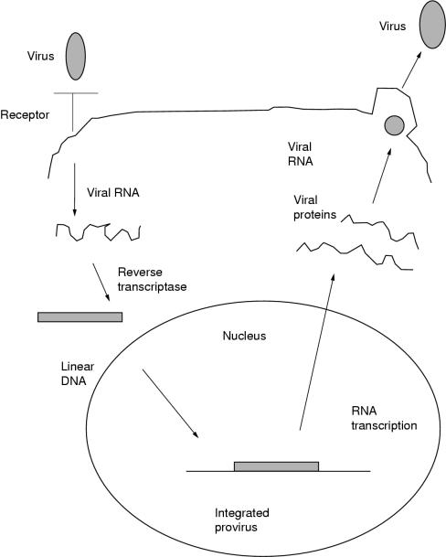
The murine leukaemia retrovirus life cycle.

Slide 20
Retrovirus vectors
A retroviral vector consists of proviral sequences that can accommodate the gene of interest, to allow incorporation of both into the target cells. The vector also contains viral and cellular gene promoters, such as the CMV promoter, to enhance expression of the gene of interest in the target cells.

Slide 21
Retrovirus-Mediated Gene Transfer
The most useful vectors for the purpose of gene isolation are those that lend themselves to the production of libraries consisting of overlapping fragments of genomic DNA, ideally encompassing the entire genome several times.
Exmaple; bacteriophage λ genomic library of 10⁶ viruses each containing on average 20 Kb of DNA (i.e human), represents 6-7 copies of the entire mouse genome and the probability that each gene is represented is very high.
Retroviruses can be used for the transfer of foreign genes into animal genomes.

Slide 22
This can best be done at 4-16 cell stage embryos. However, it can be done up to mid-gestation, but with incomplete infections i.e low infectivity rate.
Immediately following infection, the retrovirus produces a DNA copy of its RNA genome using its reverse transcriptase.
Completion of this process requires that the host cell undergoes the S phase of the cell cycle. Therefore, retroviruses effectively transduce only mitotically active cells.
Modifications to the retrovirus frequently consist of removal of structural genes, such as gag, pol, and env, which support viral particle formation.

Slide 23
Additionally, most retroviruses and complementary lines are ecotropic in that they infect only in certain species i.e rodents, such as rats and mice, and rodent cell lines rather than humans.
The DNA copy of the viral genome, or provirus, integrates randomly into the host cell genome, usually without deletions or rearrangements.
Because integration is not by homologous recombination (not target-directed), this method is not used effectively for site-directed mutagenesis.
Very high rates of gene transfer are achieved with the use of retroviruses.

Slide 24
Disadvantages of Retrovirus-Mediated Gene Transfer include:
Low copy number integration.
Additional steps are required to produce retroviruses.
Limitations on the size of the foreign DNA insert (usually 9 to 15 kb) transferred.
Potential for undesired genetic recombination that may alter the retrovirus.
High frequency of mosaicism.
Possible interference by integrated retroviral sequences in transgene expression.

Slide 25
The genome of the retroviral strain can be integrated into the same nucleus as the transgene. This means that the virus itself could be produced by the transgenic organism and create a problem especially if the animal will be used for production of food.
Also the provirus attracts methylation which possibly in conjugation with other mechanisms disables its expression when it passes through the germ line.
Due to this, and to the availability of other alternative methods, the retroviral vector method is rarely used for producing transgenic animals that have a commercial potential.

Slide 26
DNA Microinjection Method
Because of the disadvantages of the retroviral vectors, microinjection of DNA is currently the preferred method for producing transgenic mice.
First: the gene of interest needs to be constructed in the proper form. A linear transgene construct is made, containing:
the structural gene of interest, including introns
a strong mouse gene promoter and enhancer to allow the gene to be expressed
vector DNA to enable the transgene to be inserted into host DNA
Second: The immature female mice will be induced to superovulate by sequential administration of FSH/LH and HCG and mated to fertile males. One-celled embryos are flushed from the oviducts placed in a drop of medium and viewed by phase-contrast or interference microscopy.

Slide 27
Steps of DNA Microinjection
The number of available fertilized eggs that are to be inoculated are increased by stimulating donor females to superovulate.
This can be done by
Giving the mice an initial injection of pregnant mare’s ( an adult female of horse or related mammal) serum containing Pregnant Mare's Serum Gonadotropin (PMSG)
Another injection about 48 hours later of human chorionic gonadotropin (hCG). By this protocol, the female produces about 35 eggs instead of the normal number of 5-10.

Slide 28
These females are mated, then sacrificed, and the fertilized eggs (oocytes) are flushed from their oviducts and recovered.
Eggs are treated with hyaluronidase to remove adherent follicle cells.
Unfertilized eggs are discarded
The eggs are inoculated immediately with the transgene, briefly;
embryo at the pronuclear stage is held in place by suction.
a micro needle loaded with a suspension of plasmid DNA will be prepared.
It is introduced through the zona pellucida and plasma membrane into the most accessible pronucleus (usually the male) and
several hundred molecules of the recombinant DNA are injected in a volume of approximately 1 picoliter (pl).
on a good day several hundred eggs can be injected.
The male pronucleus can be located using a dissecting microscope and the eggs then can be manipulated, oriented and held in place while the DNA is microinjected.

Slide 29
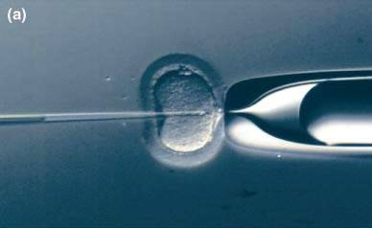
oocyte
Pippet
Micro needle

Slide 30
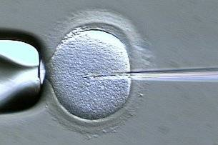

Slide 31
After inoculation, 25-40 eggs are implanted microscopically into a foster mother who has been made pseudo-pregnant by being mated to a vasectomized male so that none of the eggs of the foster mother will be fertile therefore, the foster mother will deliver pups from the implanted fertile eggs three weeks after the inoculation.
After birth, the presence of foreign material is studied by DNA hybridization with appropriate probes or PCR.
A transgenic mouse can be mated to another to produce a homozygous transgenic animal.

Slide 32
Advantages and disadvantages of the DNA microinjection
A. Advantages of DNA microinjection:
1. A high frequency of generating transgenic animals from viable microinjected embryos transferred to recipient females.
2. A lack of constraint on the size or type of DNA constructs used.
3. The stability of the transgene as it is transmitted from generation to generation.
B. Disadvantages of DNA microinjection:
1. The random and potentially significant influence that the site of integration can exert on transgene expression (positional effects).
2. The potential for undesired insertional mutagenesis.
3. The time required to develop the necessary micromanipulation and microinjection skill sets.
4. Process is expensive

Slide 33
Sperm-mediated gene transfer Sperm mediated gene transfer (ICSI-Tr)
A method for introducing exogenous DNA into animals for producing transgenics. Sperms of many species have been shown to bind naked DNA as well as DNA-liposome complexes.
Sperm are collected at ejaculation or from the epididymis of the testis. It is then incubated in fertilization medium at 37-39 ◦C for varying lengths.
Exposed perinuclear theca of the sperm head would interact with the DNA and act as a carrier for the transgene.
Sperm-DNA complex is then injected into mature metaphase II-oocytes by ICSI, allowing the transgene to be transferred into the embryonic genome via the DNA repair mechanism.
One of the main advantages of ICSI-Tr is its higher efficiencies at inserting very large DNA fragments into the host genome, including inbred mice, as compared to pronuclear microinjection

Slide 34
Why transgenic animals and some applications:
1) To meet the growing demand for animal products (meet, milk …etc.), to increase the size of the animal or its products
2) Production of human proteins for medical use.
-Tissue plasminogen VIIIn activator for blood clotting produced by goats
-Factor VIII and Factor IX are produced in sheep for the treatment of blood clotting disorders such as hemophilia
-AntithrombinIII, produced in goats, for prevention of blood clotting
-Cystic fibrosis transmembrane conductor regulator (CFTR) for treatment of cystic fibrosis genetic disorder
-Human protein C produced by pigs for use as an anticoagulant
34

Slide 35
Why transgenic animals and some applications:
3. Xenotransplantation: the production of tissues and organs in animals for use in humans such as:
-Producing pigs without 1-galactosyle transferase, a protein linked to human tissue rejection by knocking out the gene coding to this protein in pigs.
4. Altering milk lactose improving the shelf time of milk or reducing the amount of water in milk.
5. Increasing disease resistance ability in farm animals
6. Production of novel products by farm animals such as Spider-silk protein in transgenic goats in their milk.

Slide 36
Why transgenic animals and some applications:
7. Application in Insects
-Control Insect populations such as producing transgenic mites that are very effective predators of the spotted spider mites that infest strawberries and ornaments.
-Producing genetically engineered by decreasing their period of incubation baculoviruses for biopesticides after infection of invertebrates
-Controlling transmission of pathogens such as producing mosquitoes that are resistant to the malaria parasites.
36

